Slide 1

MEMOIR-A collaborative memory keeper
CSI1007 – Software Engineering Principles
Laboratory
22MIC0009
MAHALAKSHMI BALAN

Slide 2
Memoir- Collaborative Memory Keeper
Description of the Project
The Memoir App is an innovative platform designed to capture, share, and relive daily
memories in structured and collaborative manner. This app allows users to log personal
moments, including photos, tasks, text notes, and music, directly into a calendar-based
interface. By integrating with the Google Calendar API, the app provides a seamless way to organize and visualize memories on specific dates or years.
In addition to memory keeping, the Memoir App introduces a Mood Analysis Feature,
allowing users to track their emotional state over time. This feature analyzes user input,
including journal entries, emoji reactions, and self-reported moods, to generate insights
about emotional patterns. Users can visualize their mood history through charts and receive
personalized suggestions, such as music recommendations, relaxation techniques, or journaling prompts, to enhance their well-being

Slide 3
Key features:
Daily Memory Logging – Users can save and categorize personal memories with multimedia support (photos, notes, music, and tasks).
Calendar View – Memories are displayed in an interactive calendar for easy access and organization.
Collaborative Sharing – Friends, family, or colleagues can contribute and
edit shared memories using shared login access or unique access codes. Authentication via MongoDB – Secure and personalized access with user authentication and account management. Google Calendar Integration – Users can sync memories with specific dates and years for structured recall. Mood Analysis Feature – Tracks emotional states over time based on user inputs, providing insights and personalized well-being recommendations.

Slide 4
Scope of the Memoir App
The Memoir App is a collaborative platform for capturing, organizing, and sharing daily
experiences while promoting emotional well-being. It integrates Google Calendar API for
structured memory management and includes AI-powered mood analysis for tracking emotional trends.
Aim:
To provide a dynamic and secure space where individuals and groups can log, organize, and share meaningful memories while fostering emotional awareness and deeper connections.
Objectives:
Daily Memory Logging: Users can document experiences with photos, text, tasks, and
music in a calendar-based interface for easy retrieval.
Calendar Integration: Memories are organized by date/year with Google Calendar API, allowing reminders for past events.
Collaboration & Sharing: Users can share memories with family, friends, or teams
using shared login access and unique access codes for real-time collaboration.
Mood Analysis: AI-powered mood tracking allows users to log emotions, view trends
and insights, and receive personalized well-being suggestions such as music recommendations and relaxation techniques.
User Authentication & Security: MongoDB-based authentication ensures data privacy, secure access, and role-based permissions for memory sharing.

Slide 5
Impact of the Memoir App
The Memoir App creates a meaningful space for users to preserve memories, enhance emotional well- being, and foster stronger connections through technology-driven storytelling.
Personal Impact
Structured Memory Preservation: Users can relive special moments with a well-organized calendar-based
memory system.
Enhanced Self-Reflection: Mood tracking helps users understand emotional patterns and triggers.
Personalized Well-Being Support: AI-powered suggestions encourage mindfulness, relaxation, and self-care.
Social & Emotional Impact
Strengthened Relationships: Shared access enables families and friends to collaboratively log and cherish
memories.
Bridging Long-Distance Gaps: The app fosters meaningful connections despite physical distances through
shared storytelling.
Support System for Mental Health: Users gain insights into their emotional well-being, helping them seek timely support when needed.
Technological & Community Impact
Seamless Digital Memory-Keeping: Integrating Google Calendar API provides an intuitive and structured
way to store and revisit memories.
Data Privacy & Security: Secure authentication ensures safe collaboration without data breaches.
Potential for Expansion: The app can evolve into a comprehensive wellness and journaling platform, integrating more AI-driven insights.

Slide 6
Social Impact
Strengthens relationships through shared memory collaboration. Bridges long-distance gaps with shared access codes.
Supports mental health awareness via mood tracking.
Encourages community engagement for teams and families.
Technological Impact
Uses AI-powered mood analysis for emotional insights. Integrates Google Calendar API for seamless memory tracking. Ensures secure data storage with MongoDB authentication.
Scalable for future innovations like voice notes and emotion detection

Slide 7
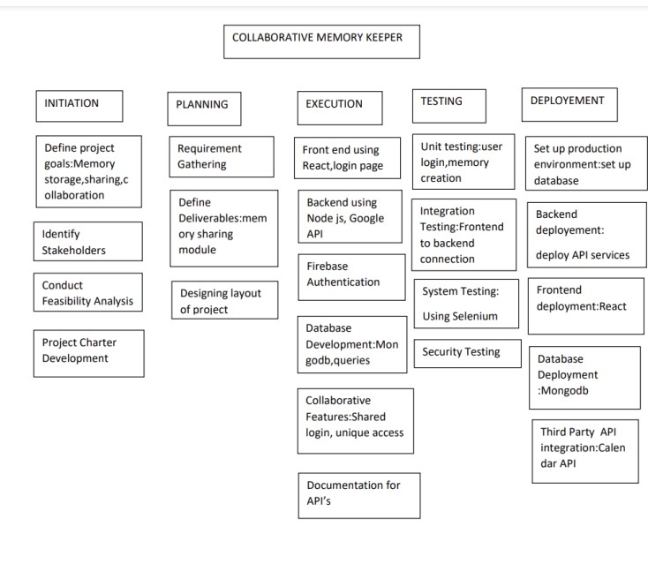
Work Breakdown Structure
Process-Based Work Breakdown Structure

Slide 8
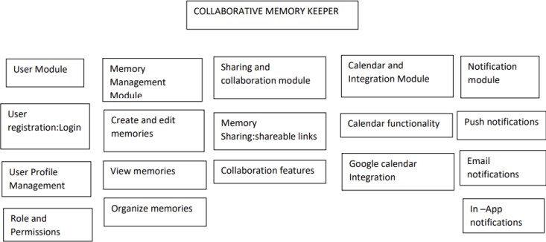
Product-Based Work Breakdown Structure

Slide 9
SRS Document
Functional Requirements of the Memoir App
User Authentication & Access Control
Secure registration, login, and logout using MongoDB authentication.
Provide password reset and account recovery options.
Memory Logging & Organization
Users can log daily memories with text, photos, tasks, and music.
A calendar interface organizes memories by date and year.
Memories can be edited, deleted, and updated.
Collaboration & Sharing
Enable shared login access for families, friends, or teams.
Provide unique access codes for controlled sharing.
Allow multiple users to view, edit, and add shared memories.
Mood Analysis & AI Insights
Implement AI-powered mood tracking based on user inputs.
Display mood trends visually over time.
Offer insights and recommendations for emotional well-being.
Google Calendar Integration
Sync memories with Google Calendar API.
Provide event reminders based on stored memories.
Security & Privacy
Ensure end-to-end encryption for secure data storage.
Allow users to control memory visibility settings.

Slide 10
Non-Functional Requirements of the Memoir App
Performance
The app should provide a smooth user experience with minimal load times.
Memory retrieval should take less than 2 seconds per query.
Scalability
The system should support an increasing number of users without performance degradation.
Should allow future integration with wearable devices for real-time mood tracking.
Security
End-to-end encryption must protect user data.
Only authorized users should access private memories.
Usability
The UI should be simple, intuitive, and easy to navigate.
Users should require minimal training to use the app effectively.
Availability
The app should maintain 99.9% uptime for uninterrupted access.
Cloud-based storage ensures data availability even in case of failures.
Compatibility
The app should be accessible on mobile, tablet, and desktop.
Support all major browsers and operating systems.
Maintainability & Updates
The system should allow easy updates and bug fixes.
Code should follow modular architecture for maintainability.

Slide 11
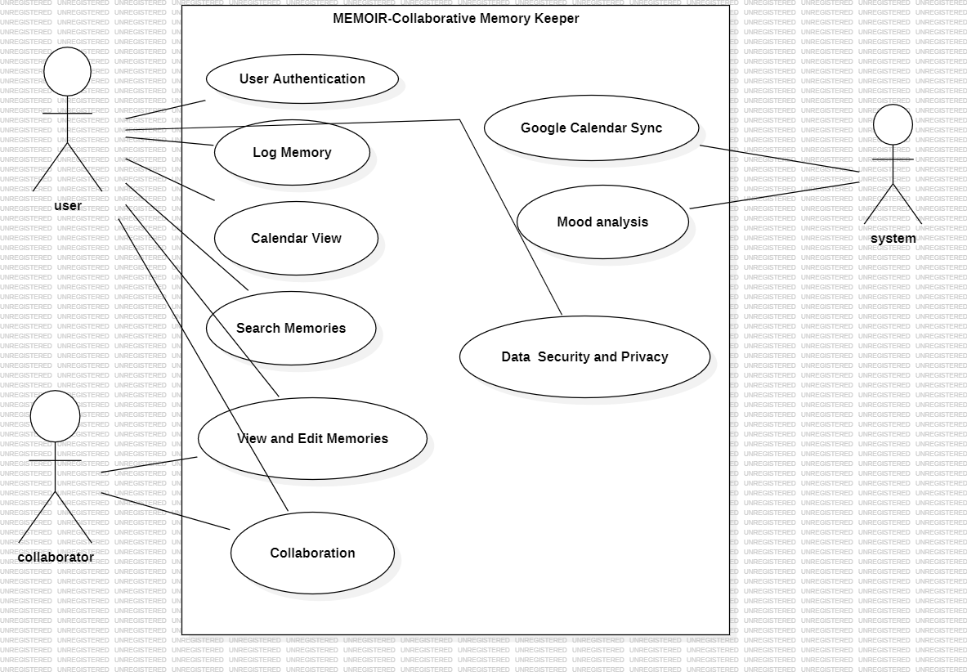
UML - Diagrams
use-case diagram

Slide 12
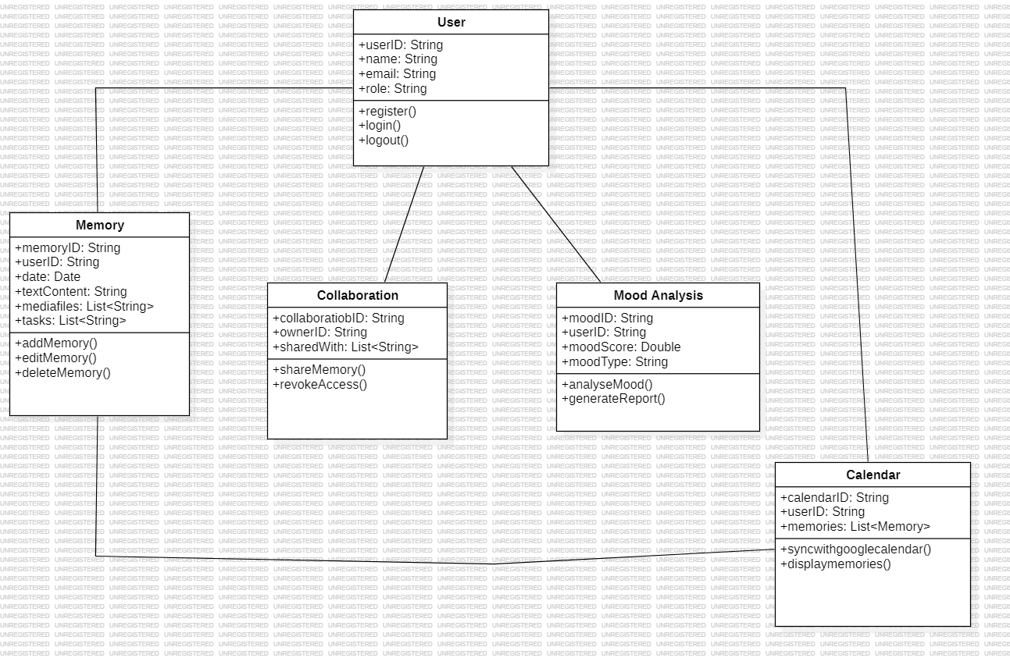
class diagram

Slide 13
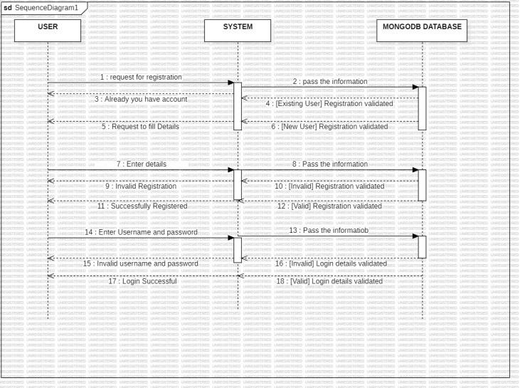
Sequence diagram
LOGIN PROCESS:

Slide 14
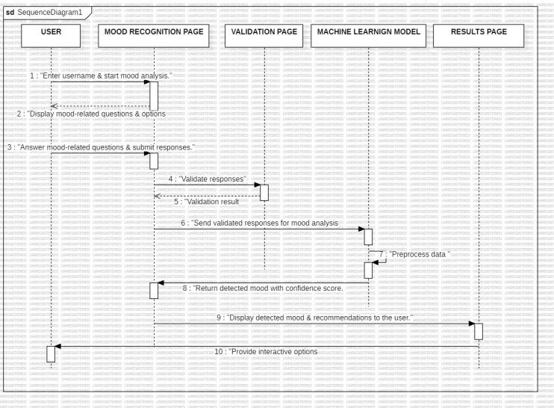
ML-Based Mood Recognition Sequence Diagram

Slide 15
Testing
Test Case 1: Memory Upload Functionality
Test Case ID: TC001
Test Scenario: Verify that a user can upload and view a memory successfully.
Test Case Description: Ensure that users can upload an image, text, or task to the memory section and view it correctly.
Test Steps:
Open the Memoir Dashboard.
Click on the "Add Memory" button.
Upload an image (review.jpg).
Enter text (“Software Engineering Lab").
Click the "Save" button.
Navigate to the selected date on the calendar.
Verify if the uploaded memory appears correctly.
Test Data:
Image: review.jpg
Text: “Software Engineering Lab"
Test Expected Result:
The uploaded memory (image and text) should be visible on the selected date in the calendar.
Actual Result:
Memory was successfully uploaded and displayed on the calendar

Slide 16
Test Case 2: Memory Sharing Feature
Test Case ID: TC002
Test Scenario: Verify that a user can share a memory with another user.
Test Case Description: Ensure that shared memories can be accessed by users with the correct link.
Test Steps:
Open the Memoir Dashboard.
Click on an existing memory.
Click "Share Memory" and copy the generated link.
Open the shared link in a new browser/tab.
Verify that the memory is accessible.
Try accessing the memory with an incorrect or expired link. Test Expected Result:
Users with the correct link should be able to view the shared memory.
Users with an incorrect or expired link should receive an error message.
Actual Result:
The memory was accessible using the correct link.
An incorrect or expired link displayed an error message: "Memory not found or expired". Pass/Fail: Pass

Slide 17
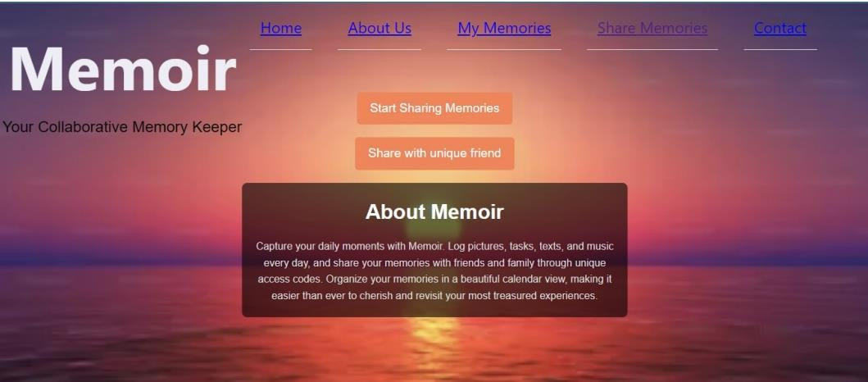
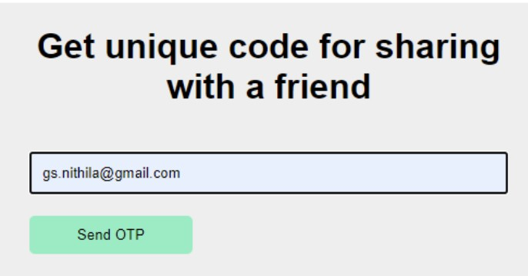
Project – UI Screenshots

Slide 18
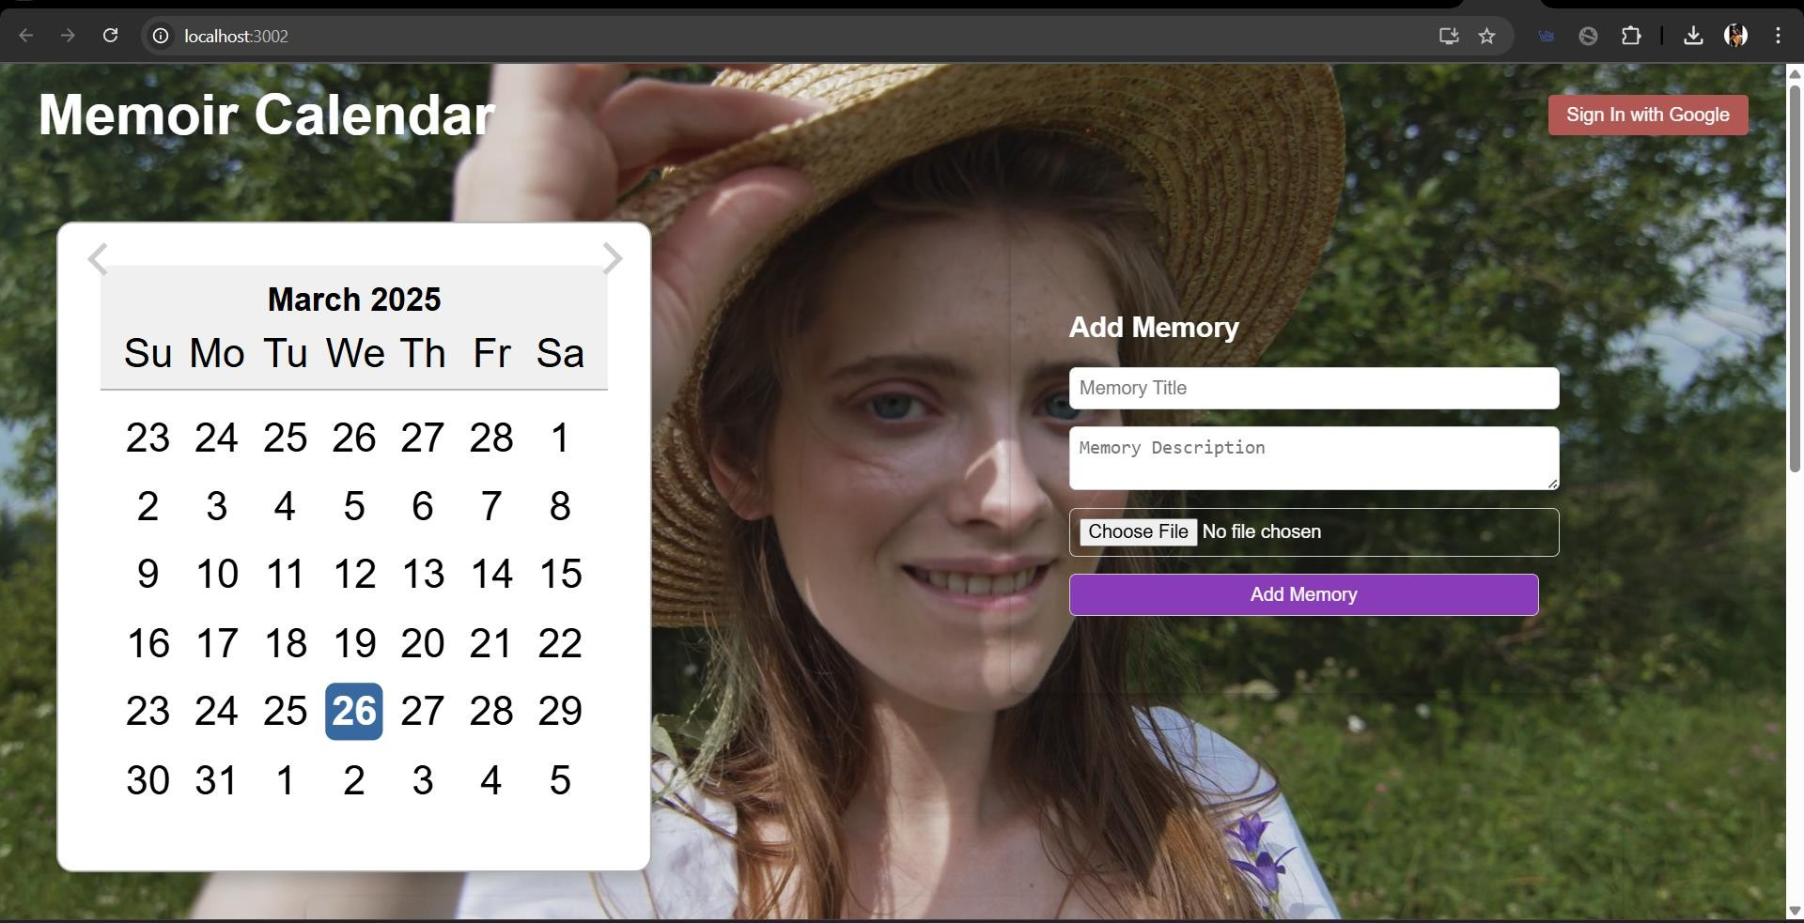
Project – UI Screenshots

Slide 19
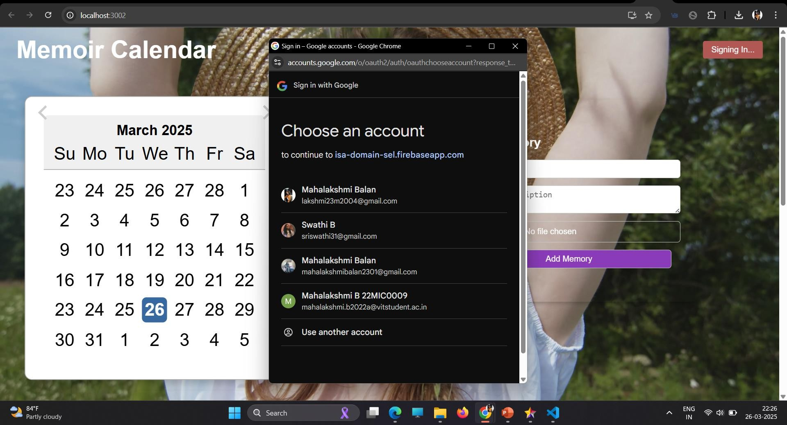

Slide 20
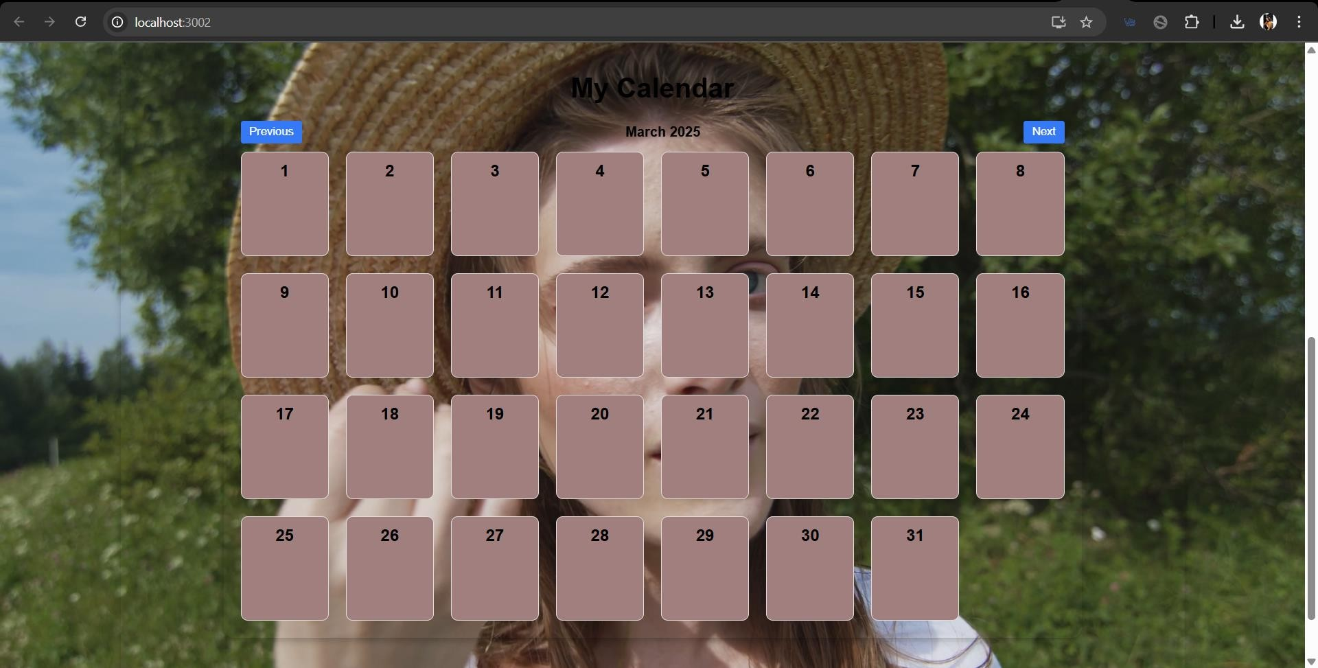

Slide 21
